Slide 1
GameCo Marketing Budget for 2017
Analysis by CG

Slide 2
GameCo
GameCo Executive Board expectation or current understanding is that:
Video Games Sales for the various geographic regions have stayed the same over time.
The goal is to distribute the marketing budget in order to maximize return on the investment.

Slide 3
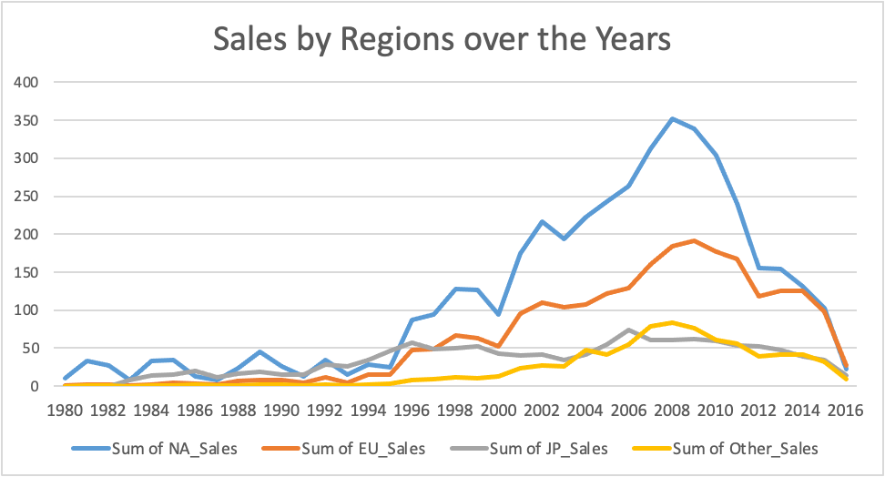
Notes:
Video Games Sales for the various geographic regions have NOT stayed the same over time.
Over the years, North America’s sales occupied the first position followed by Japan until 1996, Europe and Other Regions. After 1996 North America was followed by Europe and Japan but in 2008 the sales in Other Regions grew, surpassing Japan. This insight regarding the Other_Sales variable requires further investigation.

Slide 4
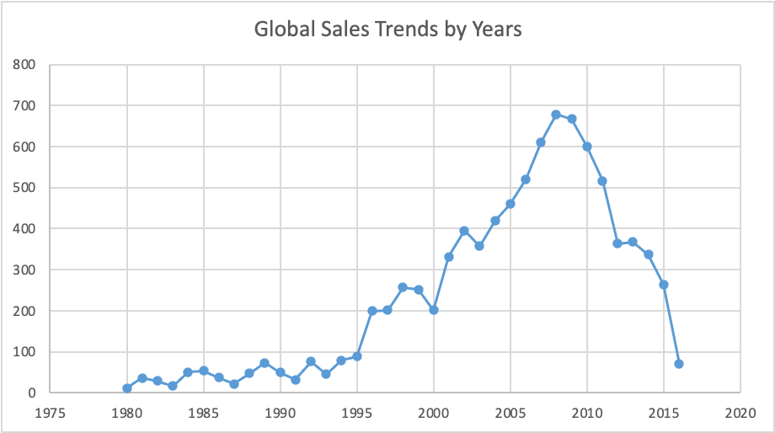
Notes:
The pick of Global Sales was in 2008, but after that there was a downward trend. An analysis of each regional sales by years will reveal further insights.

Slide 5
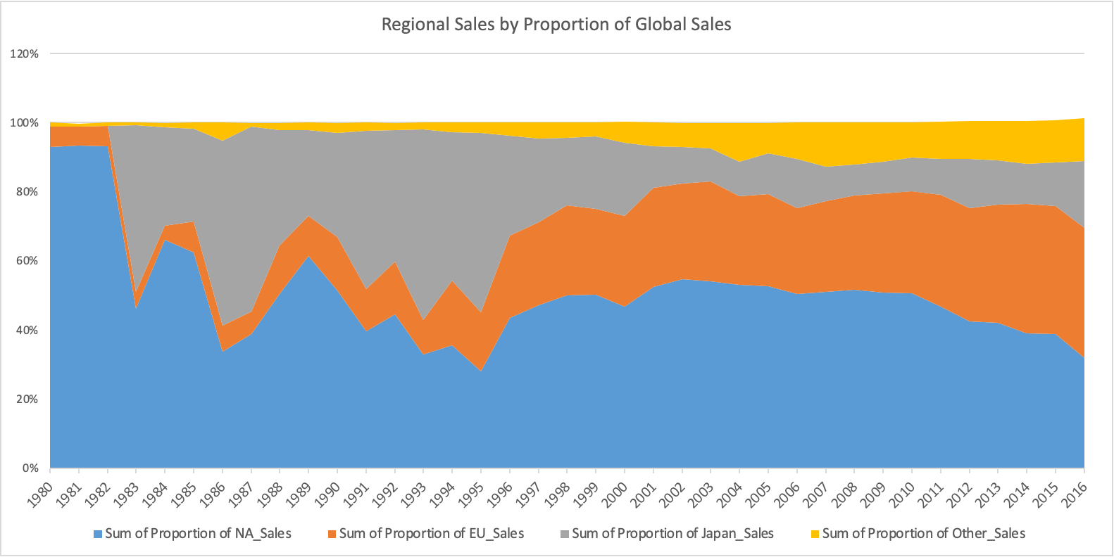
Notes:
Although North America is still the biggest market for video games, there was a downward trend for the past years. Japan is trending downward as well while Europe and the Other Regions’ sales went up for the past few years.

Slide 6
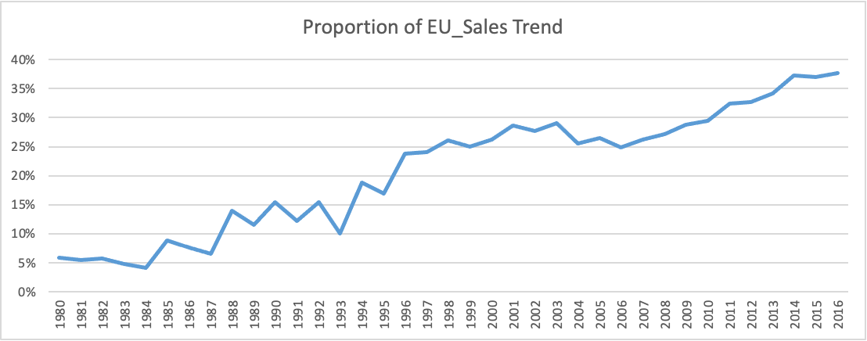
Notes:
EU Sales Trend Upward in recent years

Slide 7
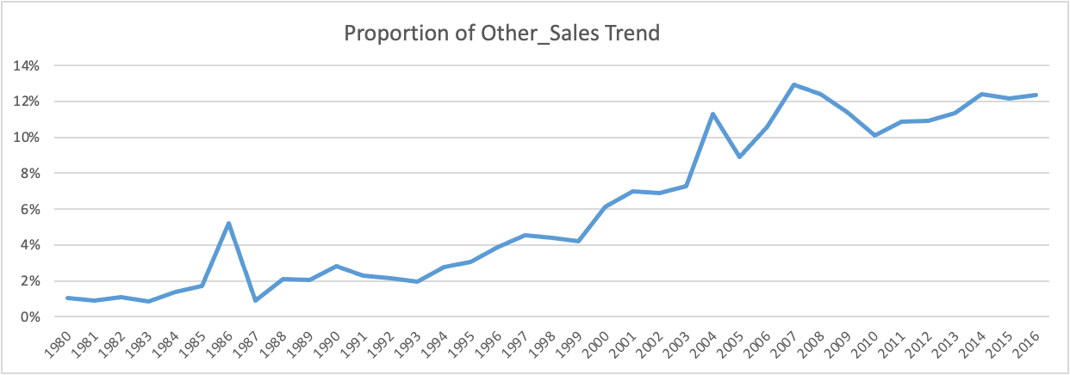
Notes:
Other_Sales Trend - potential for a new market in the following years

Slide 8
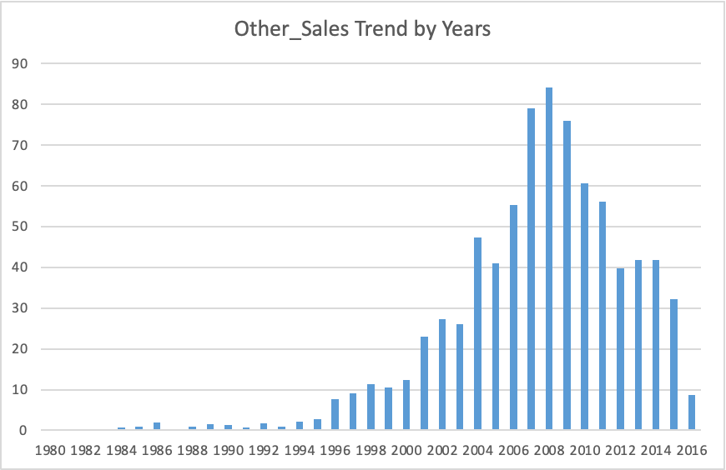
Notes:
Closer look at Other_Sales Trend by Years:
2008-the spike year.
2008-2012 - downward trend
2014-2016 - sales go down

Slide 9
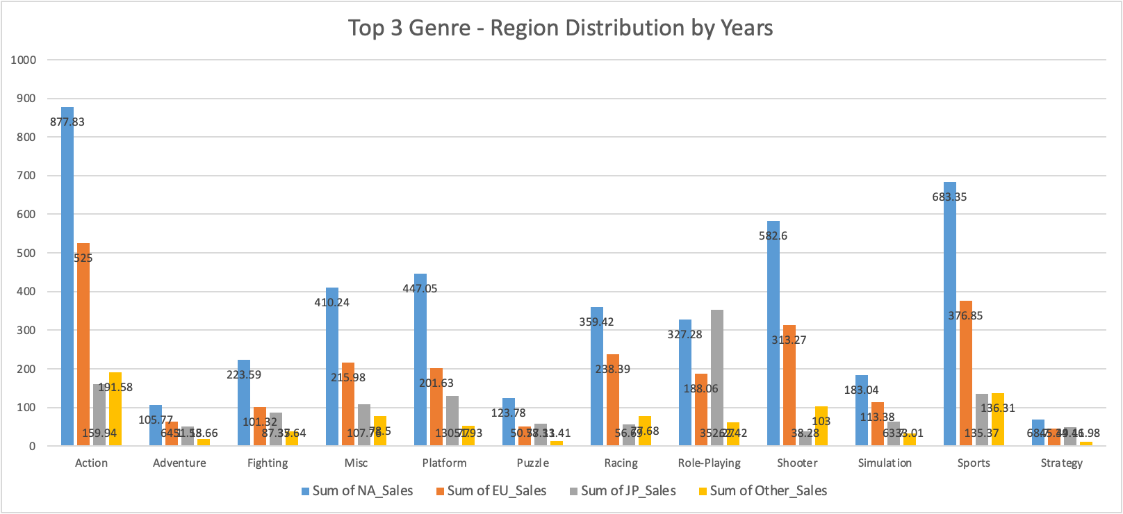
Notes:
NA: Action, Sports and Shooter
EU: Action, Sports and Shooter
Japan: Role-Playing, Action, Sports
Other_Sales: Action, Sports, Shooter

Slide 10
Insights
Video Games Sales for the various geographic regions have NOT stayed the same over time
Although North America is still the biggest market for video games, there was a downward trend for the past years
Japan is trending downward, as well
Historically, Europe and the Other Regions’ sales went up over the years
Action, Sports and Shooter are the top 3 genre for North America, Europe and other regions

Slide 11
Recommendations
As sales in Europe and Other Regions increased compared with the ‘80s, a further look into what countries in UE_Sales do well would be of potential help to see where exactly the market grows and what kind of games are the requested ones, what genre, platforms and publishers are the most successful.
Also, a regrouping of the variable "Other_Sales" or finding/knowing exactly what are the countries under the variable "Other_Sales" could be helpful. That will also clarify if sales look at countries or regions and a further analysis would be more insightful knowing this detail. So, a relabelled of the geographic areas will give us a better insight into the data.

Slide 12
Recommendations
North America continues to be the biggest market for games followed by Europe. There is a significant percentage of sales for some unknown years (N/A) for the North American market, a percentage that's higher than in the other regions. This contributes to the expectation that games will continue to do well in sales in the next years. Continue to focus on this market.
Although NA is quite a steady market for games is followed by EU and Other Regions Sales that went up over the years and these two regions would require further analysis as there is growth potential in terms of video games sales.

Slide 13
THANK YOU!

